Slide 1

THIS IS SPARTA
Florent Kirchner
Thibaud Antignac
Géraud Canet
+
Rendez-vous de la Recherche et de l’Enseignement de la Sécurité des Systèmes d’Information
Notes:
☺

Slide 2
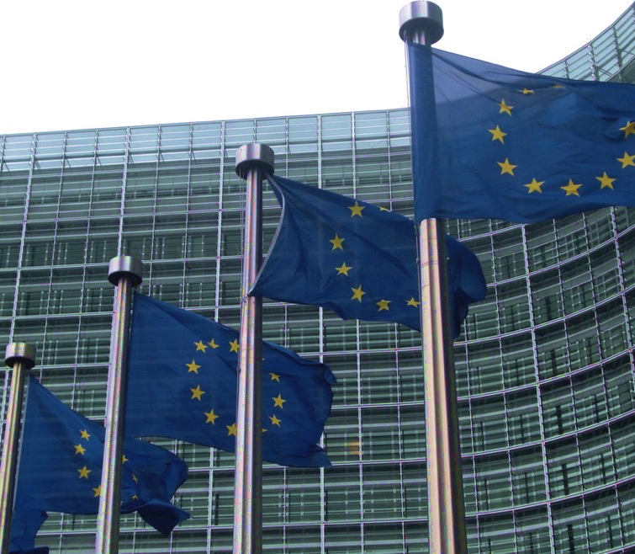
SU-ICT-03-2018
The objective of this topic is to scale up existing research for the benefit of the cybersecurity of the Digital Single Market, with solutions that can be marketable.
For this, participants should in parallel propose, test, validate and exploit the possible organisational, functional, procedural, technological and operational setup of a cybersecurity competence network.
Research, development and innovation in next generation industrial and civilian cybersecurity technologies (including dual-use), applications and services
Strengthen cybersecurity capacities across the EU and closing the cyber skills gap ;
Protect our businesses and citizens from cyber-threats
Contribute to achieve the objective of European strategic autonomy
Notes:
In 2018 Europe announced ICT-03 (+impact assessment).
And we just had to make this, because we’ve got an idea, and we wanted to see it through

Slide 3

THIS IS SPARTA
Florent Kirchner
Thibaud Antignac
Géraud Canet
+
Rendez-vous de la Recherche et de l’Enseignement de la Sécurité des Systèmes d’Information
Notes:
☺

Slide 4
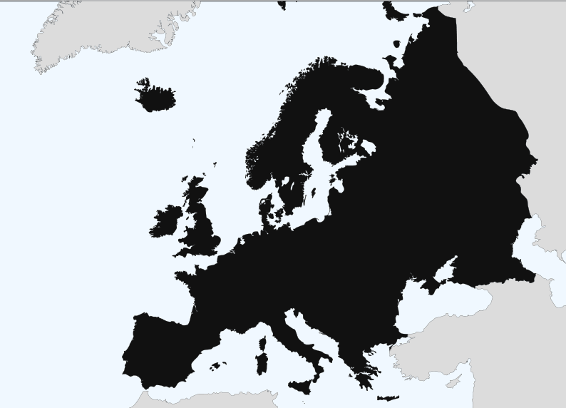

A STRONG BASIS OF EXCELLENCE
44 partners spanning academia, industry, institutions, grassroots
Pragmatically anchored in member states
STRATEGIC PROGRAMS
Multilevel supervision
Continuous and flexible evaluation Trustworthy intelligent infrastructures
Fair and secure AIs
THE STAKES OF EUROPEAN AUTONOMY
Design a long-term roadmap and network of competence centers

Slide 5

Rethinking the way cybersecurity research, innovation, and training
are performed in Europe
Develop key research and innovation paths
Demonstrate research governance on 4 R&I programs
Monitor Societal, Ethical, Legal and Privacy aspects
Setup shared and virtual spaces for collaborations
Strenghten certification, outreach, and training capacities
Pull together European, national, and regional ecosystems
Notes:
First principles

Slide 6
T-SHARK Full-spectrum cybersecurity awareness
  objective : expand the reach of threat understanding, from the current investigation-level definition, up to strategic considerations, and down to real-time events
  requires : collection of heterogeneous data, models and predictions for multi-level security, AI and visualization
  strengths : regulation encouraging information-sharing (NIS directive, French OIV law, ...), strong culture of data protection (GDPR, cryptography, ...)
  aims at : providing decision-making tools, fostering a common cyber security culture, raising preparedness for possible disruptions and attacks
  capabilities : thoroughly supervise critical systems including when they are not provided / integrated by EU actors, raise awareness and citizen involvement
CAPE Continuous assessment in polymorphous environments
  objective : enhance assessment processes to be able to perform continuously over HW/SW lifecycles, and under changing environments
  requires : binary and code verification, scalable monitoring, network reaction, HW/SW roots of trust, dynamic assurance cases
  strengths : one of the best evaluation ecosystem in the world (Common Criteria, smart cards, ...)
  aims at : building tools for continuous trust in sovereign and foreign-sourced components, systems, and services
  capabilities : drastically increase evaluation capabilities in a world where most of the components are developed outside of the EU, prepare future certification
HAII-T High-Assurance Intelligent Infrastructure Toolkit
  objective : manage the heterogeneity of the IoT by providing a secure-by-design infrastructure that can offer end-to-end security guarantees
  requires : formal security models, application security, verification and validation, verified and scalable cryptography, secure OS
  strengths : building on EU’s lead position on formal methods for safety and security
  aims at : providing a full verified software stack from applications down to the system software and SW/HW interface, which can serve in a variety of IoT devices
  capabilities : simplify the the deployment of IoT applications ; facilitate their certification
SAFAIR Secure and fair AI systems
  objective : Evaluating security of AI systems, producing approaches to make systems using AI more robust to attackers' manipulation. Furthermore, the goal is to make AI systems more reliable and resilient through enhanced explainability and better understanding of threats
  requires : adversarial machine learning, data from different AI application domains
  strengths : increasing adoption of AI technology in various information systems within EU, recent strategy of EU member states to collaborate on Artificial Intelligence
  aims at : providing methods and tools for analysis and assessment of security threats for AI systems, and solutions for protection
  capabilities : exploratory

Slide 7




Describe a concrete problem
What has been tried?
Why it is still difficult today?
What is its impact?
Do others have the same problem?
Why do we think we can succeed?
What would success look like?
IDENTIFYING CHALLENGES
The aim of a challenge is to showcase
New ways to look at issues
Concrete and transformative results
Project member consultation
At proposal-time
60+ challenges identified

Slide 8




Setup and pilots
Network operation

Slide 9
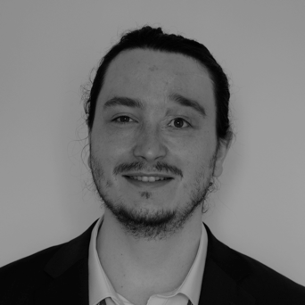
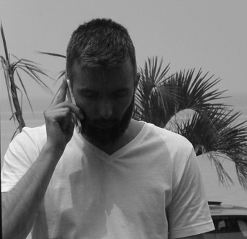
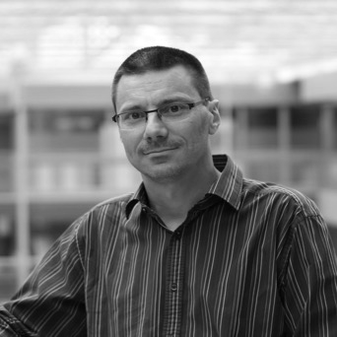
THIBAUD ANTIGNAC
Scientist
Privacy and trust
FLORENT KIRCHNER
Senior scientist
Cybersecurity program
GÉRAUD CANET
European partnerships
Security, Defense and Data Intelligence

Slide 10

SPARTA
PILOT
The performance of the defenders at the the Battle of Thermopylae
is used as an example of the advantages of training, equipment,
and good use of terrain as force multipliers and has become a
symbol of courage against overwhelming odds
Notes:
7 000 vs. 150 000
(Herodotus) George B. Grundy.

Slide 11
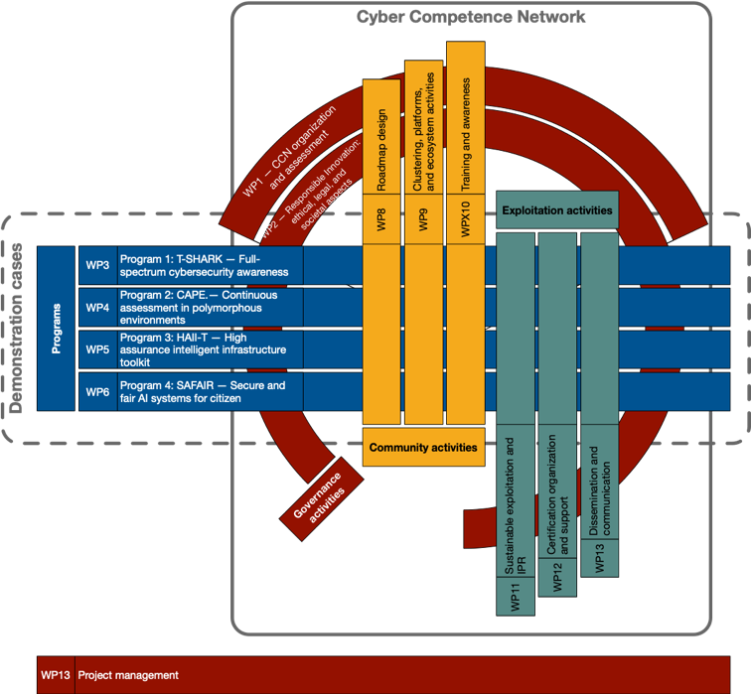

Slide 12
PROGRAMS – SPARTA PROJECT
Roadmap
Identify opportunity
De-risk opportunity
Call for proposal
Specify requirements
Results
Research area
Applicative domain
Co-construction
Structure of work areas
Expected team roles
(sci, dev, integ, eval)
Measure
Update
& pivot
S&T impact
Business impact
Roadmap
Expertise map
Proposal
Specify workplan
Team composition
Work area(s) tackled
Efforts and means
Risk mitigation
Execute
Fail early, fail often
Compete + cooperate with teams in same/other work areas
Inputs from community
PRE-SUBMISSION
PROJECT

Slide 13
JOINT COMPETENCE CENTER INFRASTRUCTURE
Digital, physical, virtual.
What makes a platform?
OPERATOR
PILOT
PLATFORM
TYPE
DISCIPLINES
EXCELLENCE
INFRASTRUCTURE
ECOSYSTEM
LICENSING
VISIBILITY
Reference location for teams
availability of infrastructure and technologies for startups and SMEs
update of a catalogue, managed with local clusters and authorities
initial catalogue a deliverable of the project, so as the identification of the themes and partners that could be involved in the first run
Reference experimentation platform for research
Reference facility for training curricula

Slide 14
ASSOCIATES COUNCIL
Include actors from
Large groups and SME
Local, National, European clusters
Regional authorities
Close academic and industrial entities
Access to
Roadmap and early program results
Networking with council and SPARTA members
Contributions to
Training, certification, and industry capability maps
Territorial animation
Incubators
Eligible to complementary late-stage project funding
First successful workshop in Paris on Apr. 20 2018, co-sponsored by Systematic and ACN.
 |  | Large groups | SME | Clusters | Region authorities | Universities
Roadmap design and results |  | X |  |  |  | X
Early program results |  | X | X
Networking |  | X | X | X | X | X
Capabilities maps | Training | X | X |  |  | X
 | Certification | X
 | Industry | X | X | X
Territorial animation |  |  | X | X | X | X
Incubators |  | X |  |  |  | X

